Slide 1
Lecture 16: Analysis of Variance
Jibo He, Ph.D.
Associate Professor
Wichita State University
jibo.he@Wichita.edu

Slide 2
ANOVA
Analysis Of Variance (ANOVA)
Generalization of t Test to independent variables with 2+ categories
A family of statistical models that examine differences between groups using variance components
Today, we will learn “one-way ANOVA”.
“One-way” refers to one factor.
Factor = a categorical variable that distinguishes the groups.

Slide 3
Examples of research question
How scores on an aptitude test vary for students in different types of schooling environments---home schooling, public schooling, and private schooling?
A market researcher wants to determine if there is a significant difference between the response rates to five different marketing campaigns.
In sum, ANOVA deals with three or more samples

Slide 4
From two-sample t-test to ANOVA
Two-sample t test
ANOVA

Slide 5
Purpose of ANOVA
What does ANOVA measure?
It measures whether there is more variation between groups than within groups.
F-ratio (named after Sir Ronald Fisher)
It is a ratio of the variation between groups to the variation within groups. It is the test statistic calculated for ANOVA.
We want to check if there is more variation between the means of several groups, relative to the variation within the groups.

Slide 6
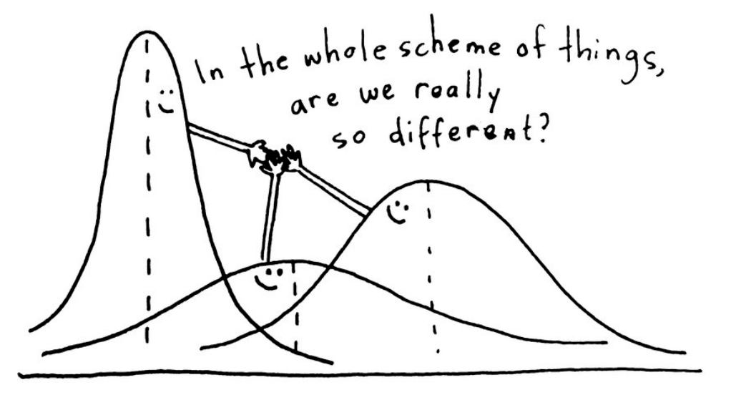
Purpose of ANOVA

Slide 7
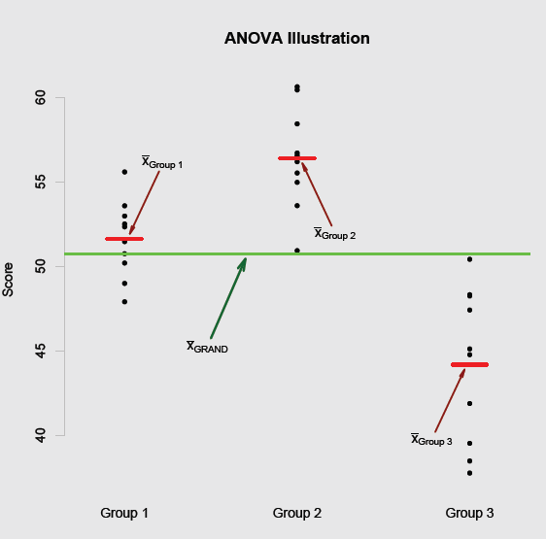
How to measure variation?
The different means
Grand mean
overall mean based on all observations
(2)Group mean

Slide 8
ANOVA Setup: Graphical display
Suppose there are three groups
Think about three things:
The variability of the points around the grand mean;
The variability of the points around the group mean;
The variability of the group means around the grand mean.

Slide 9
From different means to different types of variation
Variation: the extent to which various scores in a distribution deviate from the mean of the distribution
Within-groups variation: deviation of individual sample scores from the mean of the sample
Between-groups variation: deviations of sample means from the grand mean
Total variation: deviation of individual sample scores from the grand mean

Slide 10
Example
Suppose we are interested in treatment that purport to reduce agoraphobia (fear of unfamiliar environments) symptoms. Treatments are expensive and we also have little money for screening, so we are only able to find 12 sufferers and randomly assign them to 3 conditions:
Rational-Emotive (REBT)
Psychoanalytic (PA)
Behavioral (B)
After 12 weeks of therapy, we administer the Panic scale (higher values mean more anxiety), and we determine the total score on a random subset of questions. How can we determine whether there is difference among the treatment?

Slide 11
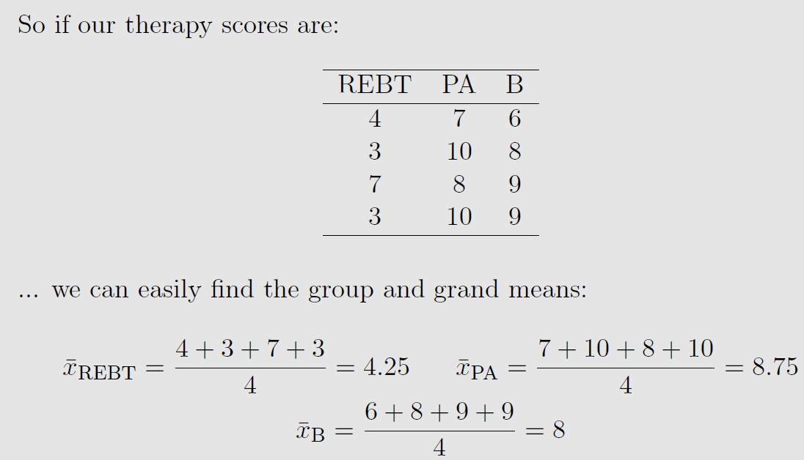
Grand and group means

Slide 12

ANOVA
Null hypothesis (omnibus test)
μ₁ = μ₂ = μ₃ = ….= μ_{k}
Alternative hypothesis
At least one μ is different
Test statistic
Procedures
Calculate “sum of squares”
Convert sum of squares to estimates of variance

Slide 13
Sum of squares
Within sum of squares SS_{W}
Find the deviation of each score in a sample from the sample mean, squaring the deviations, adding the squared deviations for each sample, and summing across all the samples.
Using the previous example, see the calculation on the board.

Slide 14
Sum of squares
Between sum of squares SS_{B}
Find the deviation of each sample mean from the grand mean, squaring the deviation, weighting the squared deviation for each sample, and summing across all the samples.
Using the previous example, see the calculation on the board.

Slide 15
Sum of squares
Total sum of squares SS_{T}
Find the deviation of each score in a sample from the grand mean, squaring the deviation, and summing across all the scores in all samples.
SS_{T} = SS_{B} + SS_{W}

Slide 16
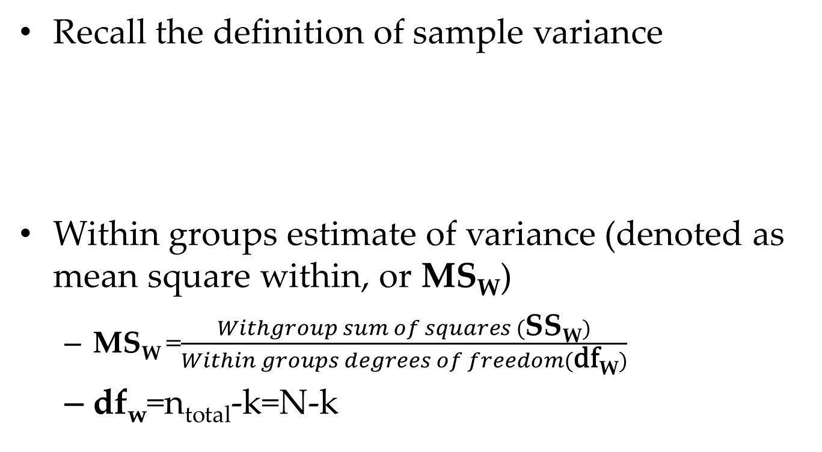
From sum of squares to estimates of variance
Recall the definition of sample variance
Within groups estimate of variance (denoted as mean square within, or MS_{W})
MS_{W} =$\frac{Withgroup sum of squares (\text{S}\text{S}\text{W})}{Within groups degrees of freedom(\text{df}\text{W})}$
df_{w}=n_{total}-k=N-k
Notes:
within-groups estimate of variance

Slide 17
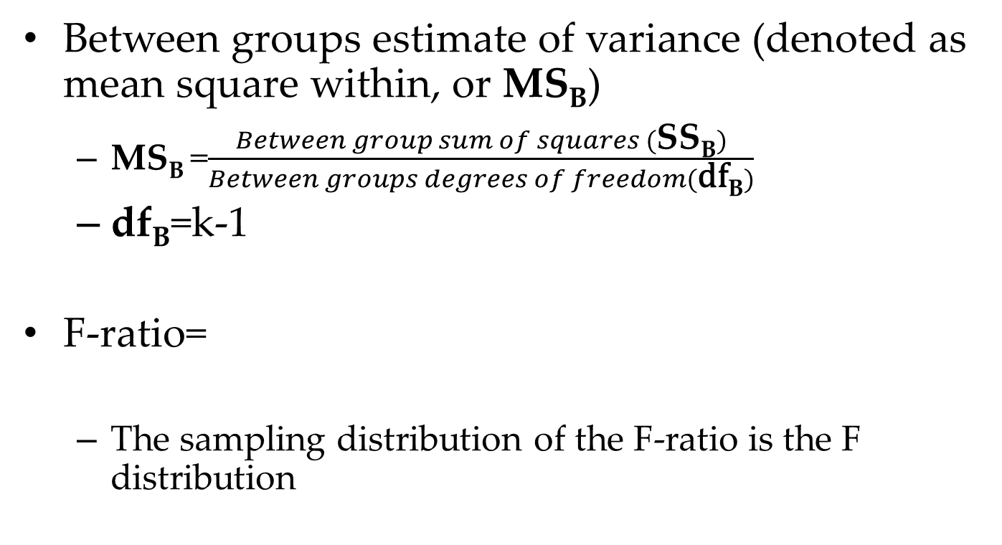
Between groups estimate of variance (denoted as mean square within, or MS_{B})
MS_{B} =$\frac{Between group sum of squares (\text{S}\text{S}\text{B})}{Between groups degrees of freedom(\text{df}\text{B})}$
df_{B}=k-1
F-ratio=
The sampling distribution of the F-ratio is the F distribution
Notes:
between-groups estimate of variance

Slide 18
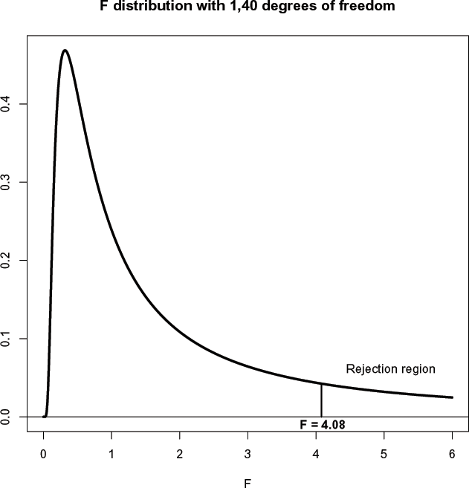
F distribution
F is named for “Fisher”, who developed the ANOVA.
It has two parameters—numerator df and denominator df F can go from 0 to infinity.
The rejection region is always in the upper tail
Notes:
V_2 related to sample size

Slide 19
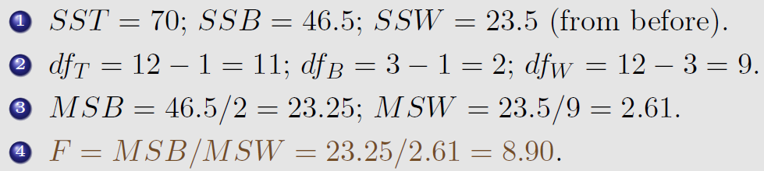
The ANOVA Table
Source | Sum of Sq. | Df | Mean Square | F-stat
Between | SSB | k-1
Within | SSW | N-k
Total | SST | N-1

Slide 20
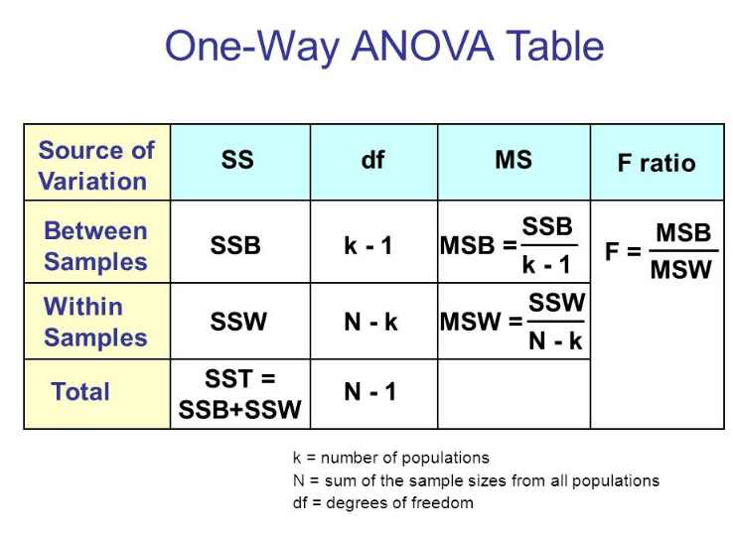

Slide 21
Another example
Craik and Lockhart (1972) proposed as a model of memory that the degree to which verbal material is remembered by the subject is a function of the degree to which it was processed when it was initially presented. Eysenck (1974) was interested in testing this model and seeing if it accounted for reported differences between young and old subjects in their ability to recall verbal material.
Eysenck randomly assigned 50 subjects between the ages of 55 and 65 to one of five groups – four incidental learning groups and one intentional-learning group. (Incidental learning is learning when the participant does not know the material needs to be recalled later.)
The data correspond to the number of words recalled.
There were 10 people per condition.

Slide 22
Data description
Groups and the instructions given to the participants:
Counting: Read a list of words and count the number of letters per word.
Rhyming: Read each word and think of words that rhyme with the word.
Adjective: For each word choose an adjective that would modify the word.
Imagery: Form vivid visual images of each word.
Intentional: Read the 27 words and try to memorize each of them.
Counting: 9, 8, 6, 8, 10, 4, 6, 5, 7, 7
Rhyming: 7, 9, 6, 6, 6, 11, 6, 3, 8, 7
Adjective: 11, 13, 8, 6, 14, 11, 13, 13, 10, 11
Imagery: 12, 11, 16, 11, 9, 23, 12, 10, 19, 11
Intentional: 10, 19, 14, 5, 10, 11, 14, 15, 11, 11

Slide 23
ANOVA: Hypotheses
Omnibus Hypotheses:
Means are tested in combination (not independent of each other)
Null:
μ₁ = μ₂ = μ₃ = μ₄ = μ₅
or
Number of words recalled does not differ across groups
Alternative
Number of words recalled differs across the groups

Slide 24
SS_{T} = (9-10.06) ² + (8-10.06)² +…+(11-10.06) ²
= 786.82
SS_{B} = 10((7-10.06) ² + (6.9-10.06)² +…+(12-10.06) ² )
= 351.52
SS_{W} = SS_{total} - SS_{B} = 786.82-351.52 = 435.3

Slide 25
ANOVA: Conclusions
Writing up the results of the omnibus test
Conclusion
Statistics in the text
Statement
Summary Table
The hypothesis that word recall did not differ across type of learning was not supported. A significant F (4, 45) ratio of 9.085, p < .05 was obtained. This leads us to conclude that recall differed depending on type of learning.

Slide 26
In-class exercise
Assume the following
.05 level of significance, four samples, 30 cases, SS_{B} =80; SS_{w} = 258
Calculate the F ratio
What is the critical value?
What would you conclude?

Slide 27
Effect size
Eta Squared (η²)
Properties
Ranges from 0 to 1
Total variation accounted for by the independent variable

Slide 28
Review and Assumptions
We are interested in whether any group differed:
F=MS_{B}/MS_{W} 1 if all groups are the same
F=MS_{B}/MS_{W}>1 if there are population differences
We performed a one-tailed F-test
If F is large, we have evidence against the null.
How large? Use F distribution.
We have three assumptions.
Independent observations
A normally distributed population
Homogeneity of variance

Slide 29
ANOVA example
Ex. A drug company tested three formulations of a pain relief medicine for migraine headache sufferers. For the experiment 27 volunteers were selected and 9 were randomly assigned to one of three drug formulations. The subjects were instructed to take the drug during their next migraine headache episode and to report their pain on a scale of 1 to 10 (10 being most pain).
Drug A 4 5 4 3 2 4 3 4 4
Drug B 6 8 4 5 4 6 5 8 6
Drug C 6 7 6 6 7 5 6 5 5
Notes:
http://www.stat.columbia.edu/~martin/W2024/R3.pdf
https://www.r-bloggers.com/one-way-analysis-of-variance-anova/

Slide 30
ANOVA in R
pain = c(4, 5, 4, 3, 2, 4, 3, 4, 4, 6, 8, 4, 5, 4, 6, 5, 8, 6, 6, 7, 6, 6, 7, 5, 6, 5, 5)
drug = c(rep("A",9), rep("B",9), rep("C",9))
migraine = data.frame(pain,drug)
plot(pain ~ drug, data=migraine)
results = aov(pain ~ drug, data=migraine)
summary(results)

Slide 31
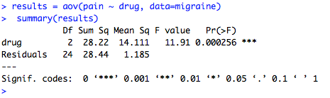
ANOVA in R

Slide 32
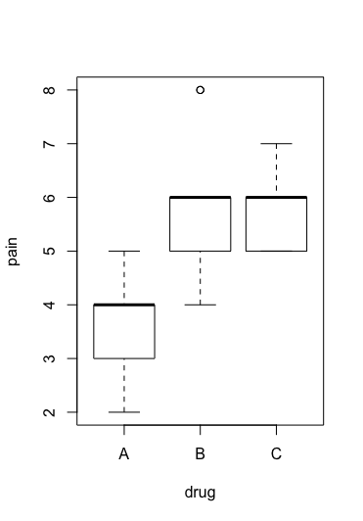
ANOVA in R

Slide 33
ANOVA in R: pairwise comparison
pairwise.t.test(pain, drug, p.adjust="bonferroni")
TukeyHSD(results, conf.level = 0.95)

Slide 34
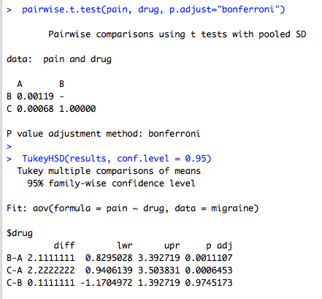
ANOVA in R

Slide 35
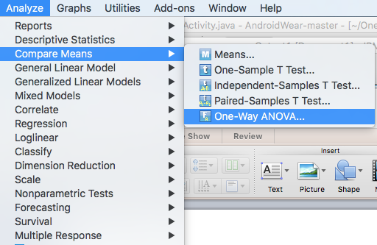
ANOVA in SPSS

Slide 36
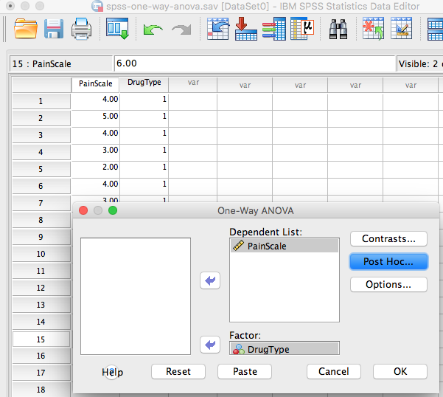
ANOVA in SPSS

Slide 37
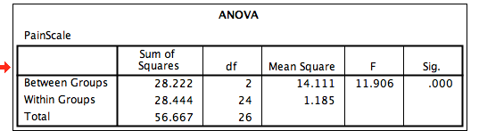
ANOVA in SPSS

Slide 38
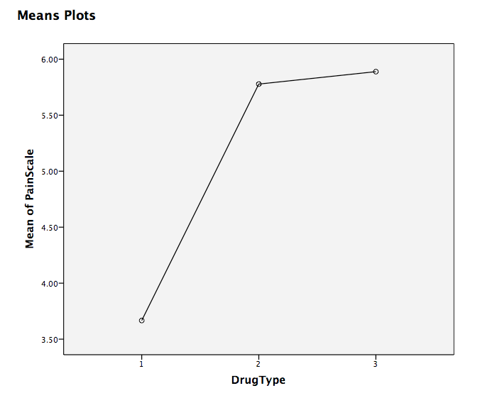
ANOVA in SPSS

Slide 39
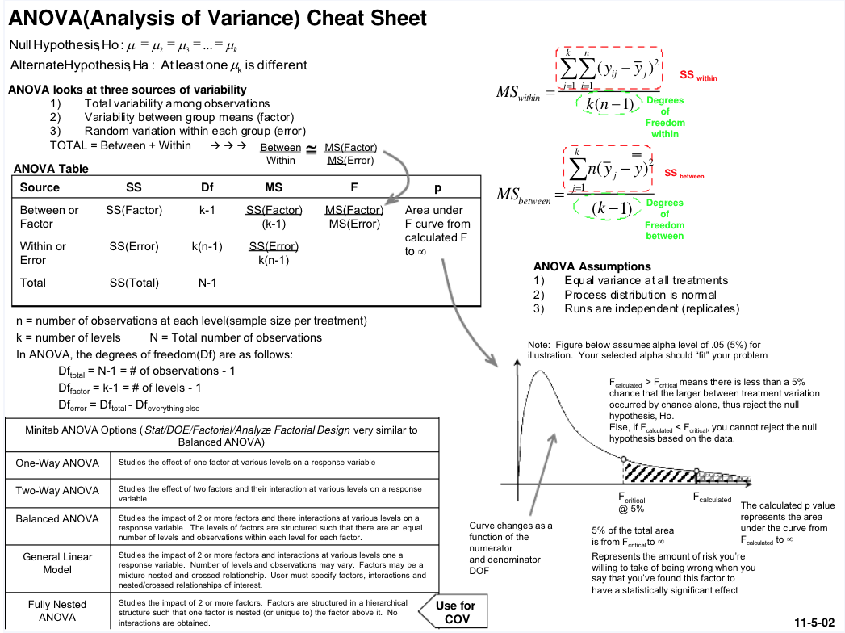
F- ANOVA Cheat sheet

